Slide 1

Presentation of Financial Results 2020

Slide 2

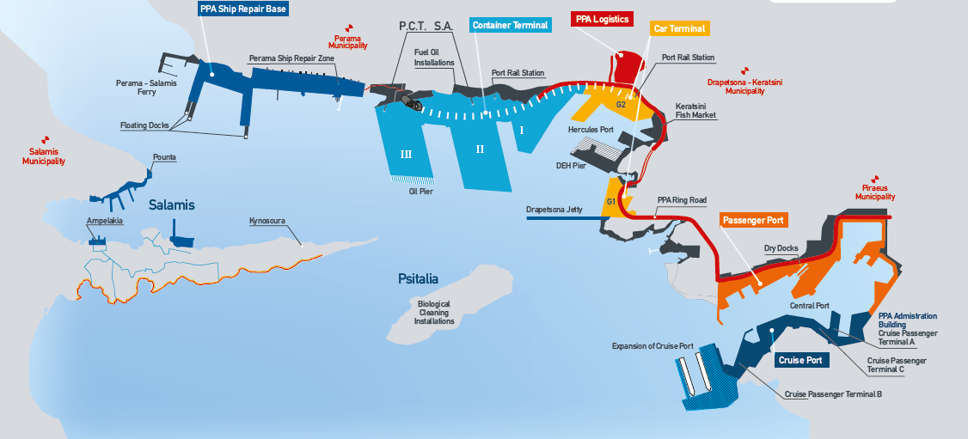
Piraeus Port map
5
1
2
4
3

Slide 3
P&L Overview

Slide 4
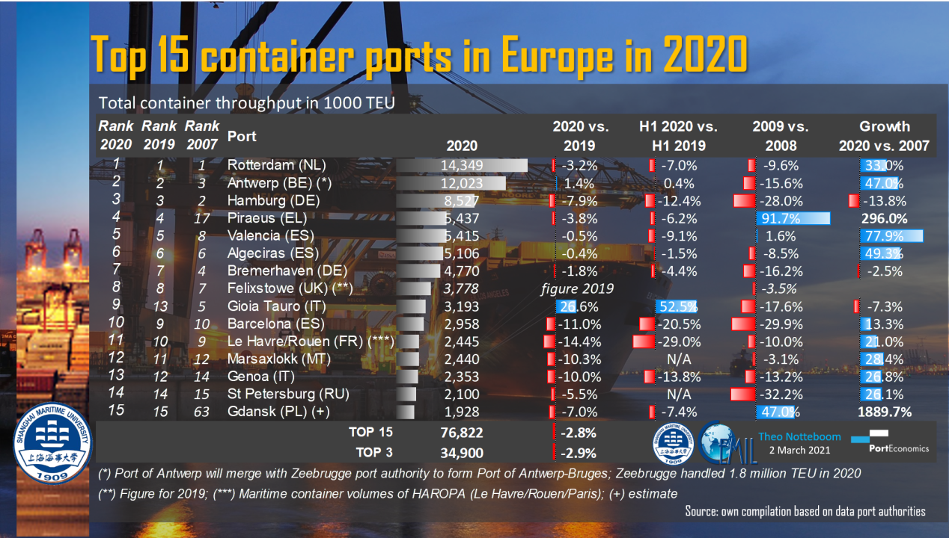
Container Terminal
Source: PortEconomics

Slide 5
Container Terminals (TEU)
1
5,437,123

Slide 6
Container Terminals Financial Results
1
CONSESSION ARRANGEMENT PIER II&III | 31.12.2016 | 31.12.2017 | 31.12.2018 | 31.12.2019 | 31.12.2020
Revenues | 40.536.647,89 | 43.940.318,82 | 56.156.249,05 | 65.768.391,78 | 66.493.707,37
Cost of sales | (7.578.562,69) | (4.224.792,74) | (4.432.549,76) | (4.119.560,48) | (3.954.346,14)
Gross profit | 36.358.085,20 | 39.715.526,08 | 51.723.699,29 | 61.648.831,30 | 62.539.361,23
Other expenses | (5.946.349,48) | (6.354.171,41) | (7.602.792,41) | (8.911.740,14) | (11.840.803,89)
Other income | - | - | - | - | -
Financial income | - | - | - | - | -
Financial expenses | - | - | - | (1.092.190,90) | (1.209.092,61)
Profit before income taxes | 30.411.735,72 | 33.361.354,67 | 44.120.906,88 | 51.644.900,26 | 49.489.464,73
Income taxes | - | - | - | - | -
Net profit after taxes | 30.411.735,72 | 33.361.354,67 | 44.120.906,88 | 51.644.900,26 | 49.489.464,73
Depreciation and amortisation | 3.465.493,48 | 3.181.637,59 | 2.433.579,82 | 3.339.558,72 | 3.680.584,79
Earnings before income taxes, financial results, depreciation and amortisation | 33.877.229,21 | 36.542.992,25 | 46.554.486,70 | 56.076.649,88 | 54.379.142,13

Slide 7
Container Terminals Financial Results
1
CONTAINER TERMINAL PIER I | 31.12.2016 | 31.12.2017 | 31.12.2018 | 31.12.2019 | 31.12.2020
Revenues | 13.100.337,37 | 20.054.626,72 | 25.119.317,36 | 25.020.351,53 | 24.303.482,47
Cost of sales | (26.746.616,43) | (32.372.168,56) | (33.583.844,20) | (32.739.342,16) | (35.112.995,40)
Gross profit | (13.646.279,06) | (12.317.541,84) | (8.464.526,84) | (7.718.990,63) | (10.809.512,93)
Other expenses | (1.903.132,01) | (2.961.516,33) | (3.366.107,19) | (3.275.715,47) | (3.583.995,30)
Other income | - | - | - | - | -
Financial income | - | - | - | - | -
Financial expenses | (145.641,07) | (172.884,31) | (663.514,81) | (1.069.805,85) | (998.915,57)
Profit before income taxes | (15.695.052,14) | (15.451.942,48) | (12.494.148,84) | (12.064.511,95) | (15.392.423,80)
Income taxes | - | - | - | - | -
Net profit after taxes | (15.695.052,14) | (15.451.942,48) | (12.494.148,84) | (12.064.511,95) | (15.392.423,80)
Depreciation and amortisation | 6.626.336,78 | 4.735.951,06 | 6.191.443,78 | 6.749.397,32 | 7.032.749,88
Earnings before income taxes, financial results, depreciation and amortisation | (8.923.074,29) | (10.543.107,12) | (5.639.190,25) | (4.245.308,79) | (7.360.758,35)

Slide 8
Car Terminal vehicles
2

Slide 9
Car Terminal Financial Results
2
CAR TERMINAL | 31.12.2016 | 31.12.2017 | 31.12.2018 | 31.12.2019 | 31.12.2020
Revenues | 11.929.860,33 | 12.074.224,07 | 13.673.252,02 | 13.886.758,26 | 11.069.491,04
Cost of sales | (7.962.336,81) | (8.634.004,63) | (8.483.092,68) | (8.223.759,77) | (8.063.875,71)
Gross profit | 3.967.523,51 | 3.440.219,44 | 5.190.159,34 | 5.662.998,49 | 3.005.615,33
Other expenses | (1.724.863,31) | (1.792.914,62) | (1.860.161,26) | (1.753.548,43) | (1.489.500,54)
Other income | - | - | - | - | -
Financial income | - | - | - | - | -
Financial expenses | - | - | - | (236.598,09) | (203.554,94)
Profit before income taxes | 2.242.660,20 | 1.647.304,82 | 3.329.998,07 | 3.672.851,97 | 1.312.559,85
Income taxes | - | - | - | - | -
Net profit after taxes | 2.242.660,20 | 1.647.304,82 | 3.329.998,07 | 3.672.851,97 | 1.312.559,85
Depreciation and amortisation | 494.757,55 | 612.768,41 | 526.753,78 | 778.547,22 | 856.729,21
Earnings before income taxes, financial results, depreciation and amortisation | 2.737.417,75 | 2.260.073,23 | 3.856.751,85 | 4.687.997,28 | 2.372.844,00

Slide 10
Cruise passengers
3
‘000 passengers

Slide 11
Cruise Financial Results
3
CRUISE | 31.12.2016 | 31.12.2017 | 31.12.2018 | 31.12.2019 | 31.12.2020
Revenues | 12.933.536,73 | 11.443.030,18 | 10.565.255,12 | 12.503.616,47 | 2.002.255,52
Cost of sales | (10.209.176,96) | (7.886.793,56) | (6.664.595,58) | (6.982.143,73) | (3.811.049,68)
Gross profit | 2.724.359,78 | 3.556.236,62 | 3.900.659,54 | 5.521.472,74 | (1.808.794,16)
Other expenses | (1.859.525,21) | (1.603.445,11) | (1.290.576,10) | (1.174.794,94) | (70.490,91)
Other income | - | - | - | - | -
Financial income | - | - | - | - | -
Financial expenses | - | - | - | (193.564,03) | (38.859,59)
Profit before income taxes | 864.834,56 | 1.952.791,51 | 2.610.083,44 | 4.153.113,76 | (1.918.144,66)
Income taxes | - | - | - | - | -
Net profit after taxes | 864.834,56 | 1.952.791,51 | 2.610.083,44 | 4.153.113,76 | (1.918.144,66)
Depreciation and amortisation | 1.276.019,84 | 1.645.916,43 | 1.395.735,47 | 1.473.767,40 | 1.261.037,61
Earnings before income taxes, financial results, depreciation and amortisation | 2.140.854,41 | 3.598.707,94 | 4.005.818,31 | 5.820.445,20 | (618.247,46)

Slide 12
Coastal passengers
4

Slide 13
Coastal Financial Results
4
COASTING | 31.12.2016 | 31.12.2017 | 31.12.2018 | 31.12.2019 | 31.12.2020
Revenues | 10.338.586,58 | 10.131.386,56 | 10.675.703,18 | 11.244.296,64 | 8.274.978,93
Cost of sales | (7.277.741,19) | (6.810.109,58) | (6.443.981,25) | (5.546.570,28) | (4.479.085,52)
Gross profit | 3.060.845,39 | 3.321.276,98 | 4.231.721,93 | 5.697.726,36 | 3.795.893,41
Other expenses | (1.471.399,87) | (1.443.421,59) | (1.398.185,20) | (1.293.225,47) | (875.650,24)
Other income | - | - | - | - | -
Financial income | - | - | - | - | -
Financial expenses | - | - | - | (182.127,67) | (153.469,20)
Profit before income taxes | 1.589.445,51 | 1.877.855,39 | 2.833.536,73 | 4.222.373,22 | 2.766.773,97
Income taxes | - | - | - | - | -
Net profit after taxes | 1.589.445,51 | 1.877.855,39 | 2.833.536,73 | 4.222.373,22 | 2.766.773,97
Depreciation and amortisation | 954.439,58 | 1.236.618,90 | 1.105.575,92 | 1.193.565,76 | 1.184.217,32
Earnings before income taxes, financial results, depreciation and amortisation | 2.543.885,10 | 3.114.474,29 | 3.939.112,65 | 5.598.066,65 | 4.104.460,49

Slide 14
Ship Repair/vessel
5

Slide 15
Ship Repair Financial Results
5
SHIP REPAIRING (TANKS AND DOCK) | 31.12.2016 | 31.12.2017 | 31.12.2018 | 31.12.2019 | 31.12.2020
Revenues | 6.889.884,36 | 6.886.976,78 | 9.463.939,14 | 11.859.676,17 | 13.786.557,81
Cost of sales | (4.826.561,90) | (5.347.464,08) | (6.547.676,65) | (9.992.112,97) | (9.865.904,87)
Gross profit | 2.063.322,46 | 1.539.512,70 | 2.916.262,49 | 1.867.563,20 | 3.920.652,94
Other expenses | (932.471,23) | (1.079.440,42) | (1.460.777,96) | (1.740.136,04) | (2.570.471,95)
Other income | - | 554.900,52 | 1.021.970,19 | 943.357,72 | 1.085.692,93
Financial income | - | - | - | - | -
Financial expenses | - | - | - | (209.535,43) | (272.072,39)
Profit before income taxes | 1.130.851,23 | 1.014.972,80 | 2.477.454,72 | 861.249,45 | 2.163.801,53
Income taxes | - | - | - | - | -
Net profit after taxes | 1.130.851,23 | 1.014.972,80 | 2.477.454,72 | 861.249,45 | 2.163.801,53
Depreciation and amortisation | 642.162,52 | 1.022.457,27 | 1.196.939,26 | 2.194.520,46 | 2.358.492,24
Earnings before income taxes, financial results, depreciation and amortisation | 1.773.013,75 | 2.037.430,07 | 3.674.393,98 | 3.265.305,34 | 4.794.366,16

Slide 16
Balance Sheet Overview

Slide 17
Expenses Overview
*From the adoption of IFRS 16, this liability refers to the variable amount excludes the minimum annual fee regarding the current period of € 3,500,000.00 with a corresponding decrease in the expense account “Concession agreement fee”. The figures on the table include the minimum fee for comparison reasons.

Slide 18
Balance Sheet Overview: Net Debt
*PPA leases due to the adoption of IFRS 16 recognized lease liabilities and right-of-use assets. These liabilities were measured at the present value of the remaining lease payments, discounted using the leases’ incremental borrowing rate as of 1 January 2019.

Slide 19
Summary of Mandatory Investments
Mandatory Enhancement | Item Name | Concession Agreement Reference Amount | Reference amount of contracted projects | Construction Contract Amount | Accumulated Investment Amount (until Dec 31 2020)
ME01 | Passenger Terminal Expansion (South Zone - Phase A) | 136.283.800 | 136.283.800 | 102.954.367 | 14.332.020
ME02 | Repair of pavements, rails and RMG cranes of Pier I Container Terminal | 8.000.000 | 8.000.000 | 6.800.475 | 2.771.170
ME03 | Convertion of Pentagonal Warehouse to Passengers Terminal | 1.500.000 | 0 |  | 12.358
ME04 | Underground Tunnel for the connection of G2 Car Terminal to the ex-ODDY area. | 5.000.000 | 0 |  | 55.565
ME05 | Upgrade and maintenance of Port Infrastructure | 15.000.000 | 1.270.483 | 854.467 | 645.519
ME06 | Supply of Equipment | 25.000.000 | 21.500.000 | 21.500.000 | 9.500.869
ME07 | Dredging of Central Port | 8.000.000 | 0 |  | 69.028
ME08 | Studies | 5.000.000 | 5.000.000 | 9.600.000 | 2.336.297
ME09 | Construction of New Oil Terminal | 15.000.000 | 15.000.000 | 19.541.587 | 20.846.402
ME10 | Expansion of Ro-Ro (Car) Terminal - Hrakleous Pier | 20.000.000 | 0 |  | 193.355
ME11 | Improvement of Infrastructure of Ship Repair Zone (Including floating docks) | 55.000.000 | 55.000.000 | 50.353.403 | 32.237.532
Total amount € without VAT (A) |  | 293.783.800 | 242.054.283 | 211.604.300 | 83.000.115

Slide 20
Share Performance

Slide 21
Thank you for your attention!
Contact details:
Nektarios Demenopoulos
Deputy Manager
PR, IR & Company Announcements Dpt.
Tel.: +30 210 4550226
Mob.: +30 694 7931026
Email: demenopoulosn@olp.gr
Url: www.olp.gr
Notes:
21

